Slide 1
ART4320 Photography II Student Practice Student Name:
Due date:
Submit your PPT by answering all questions.
1 Monochromatic
1 Analogous
1 complimentary

Slide 2
Student Practice: Monochromatic scheme

Slide 3
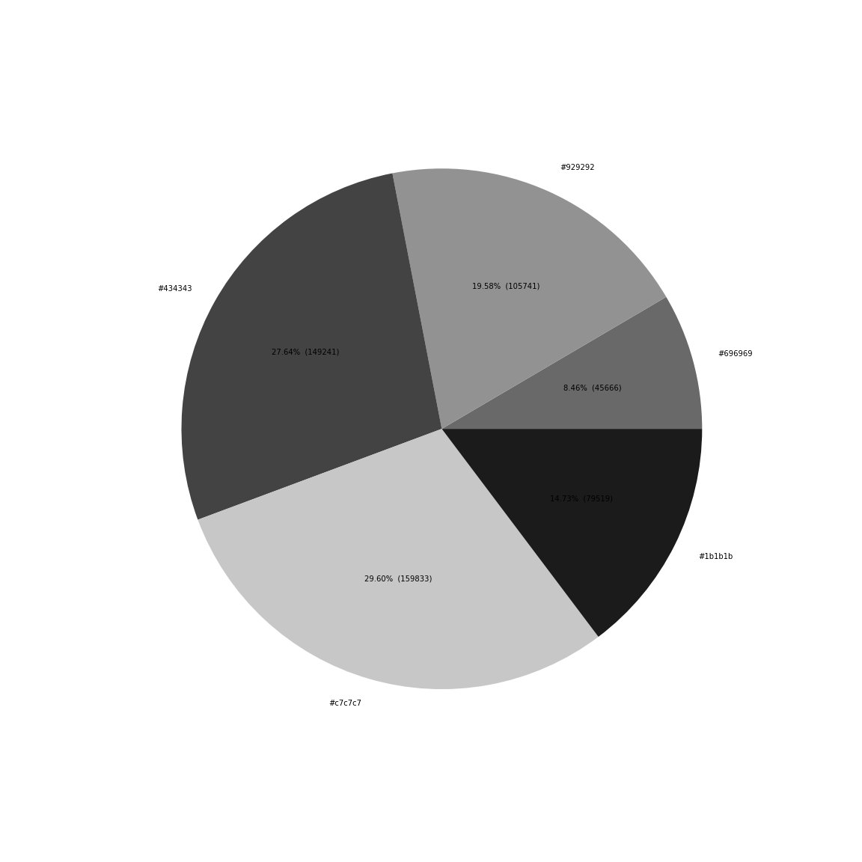
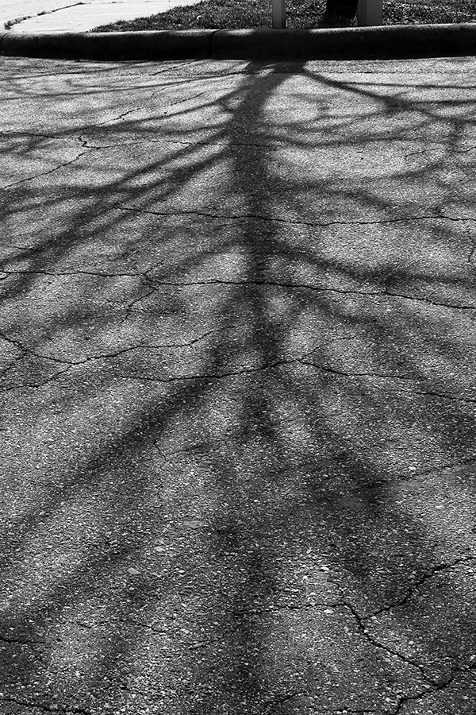
1-1. Monochromatic Example
Explain color harmony with color combination: Monochromatic color scheme with gray tones.
Write 5 hex colors with percentages: #929292(19.58%), #696969(8.46%), #1b1b1b(14.73%), #c7c7c7(29.60%), #434343(27.64%).
Which color is the most used? #c7c7c7 (29.60%)
What is the brightest color? #c7c7c7 (29.60%)
What is the darkest color? #1b1b1b(14.73%)

Slide 4

Improvement plan based on color analysis
6. Please write any suggestions to have better color harmony (2-3 sentences).
This photo needs more light tones. It can increase exposure when you take a picture. Or you can edit the photo by increasing brightness.

Slide 5
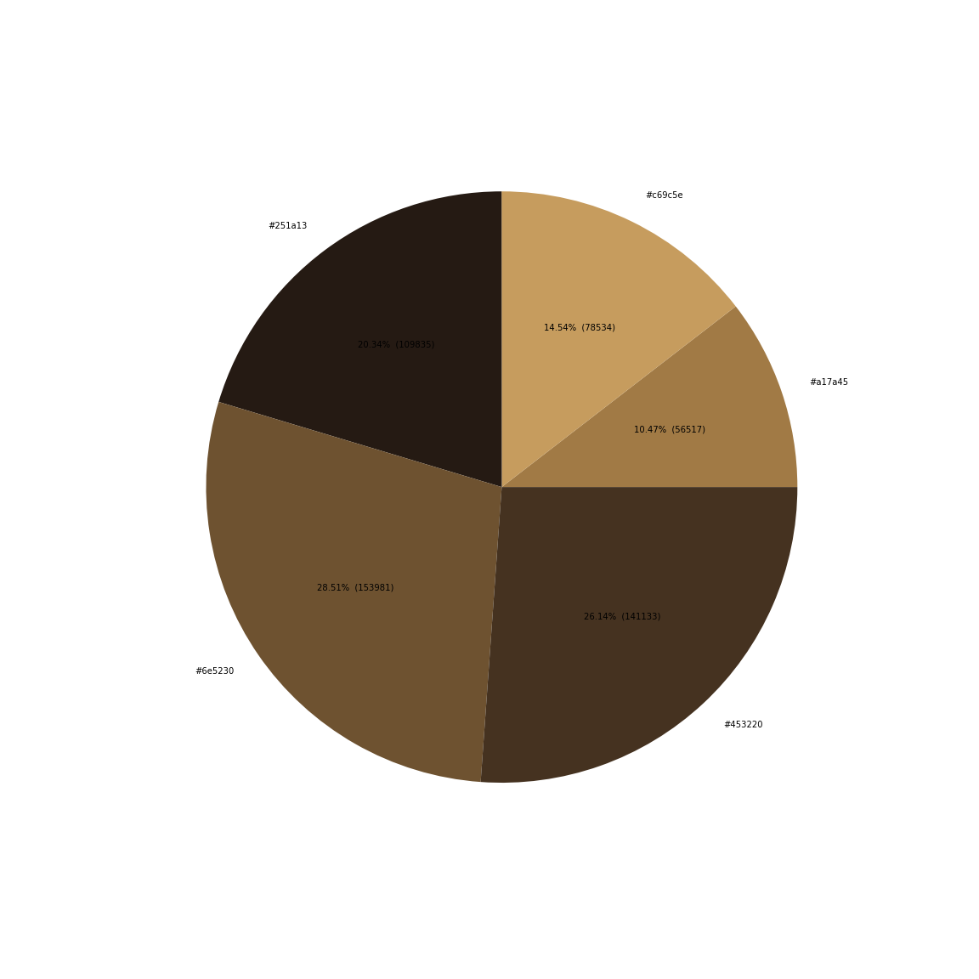
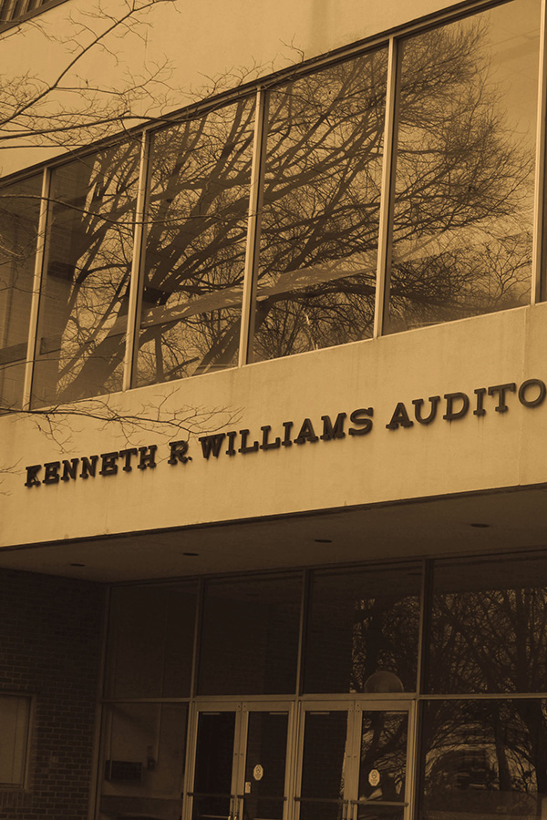
1-2. Monochromatic
Explain color harmony with color combination:
Write 5 hex colors with percentages:
Which color is the most used?
What is the brightest color?
What is the darkest color?

Slide 6
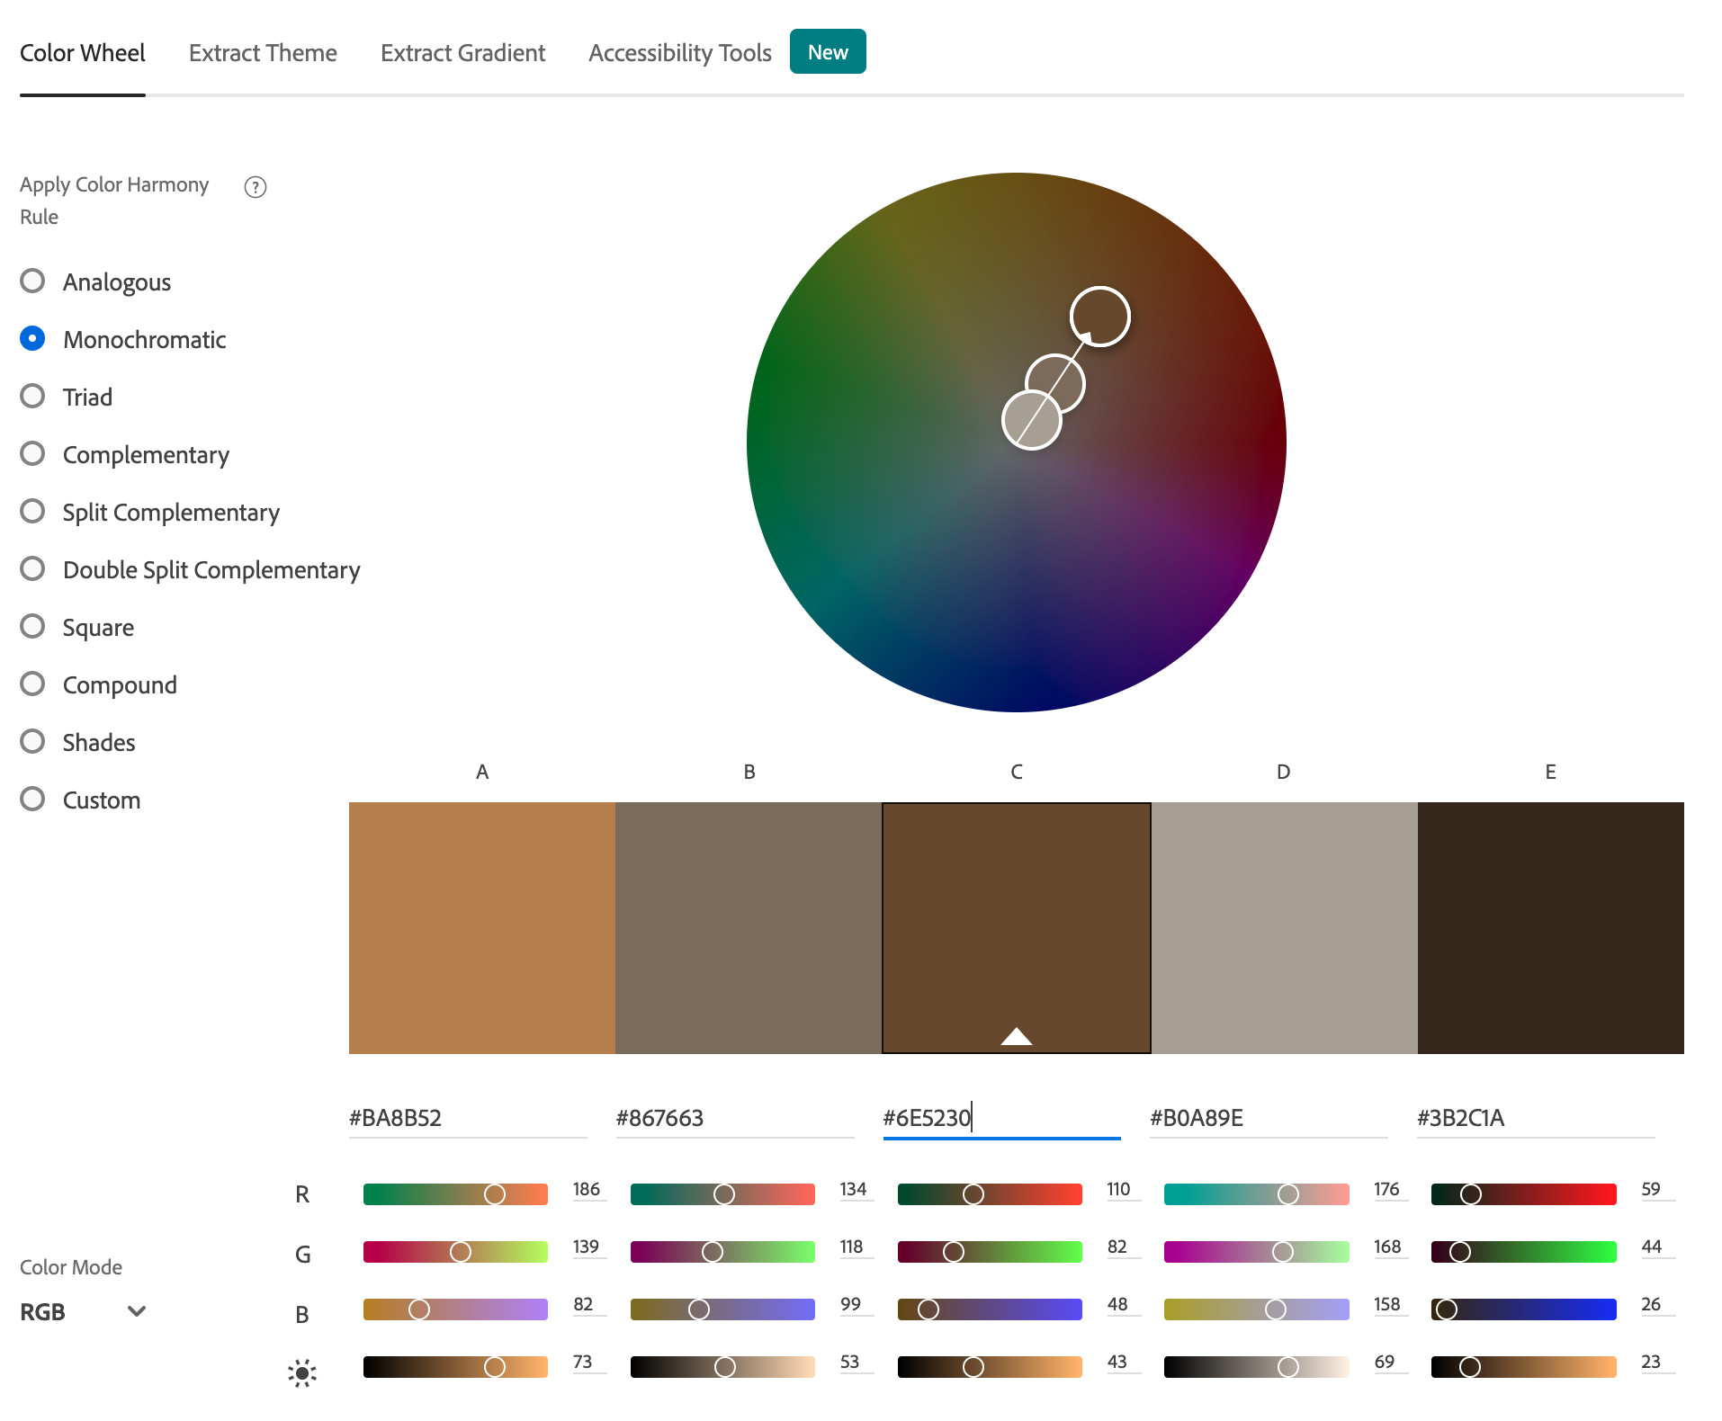
Improvement plan based on color analysis
6. Please write any suggestions to have better color harmony (2-3 sentences).

Slide 7
Student Practice: Analogous scheme

Slide 8
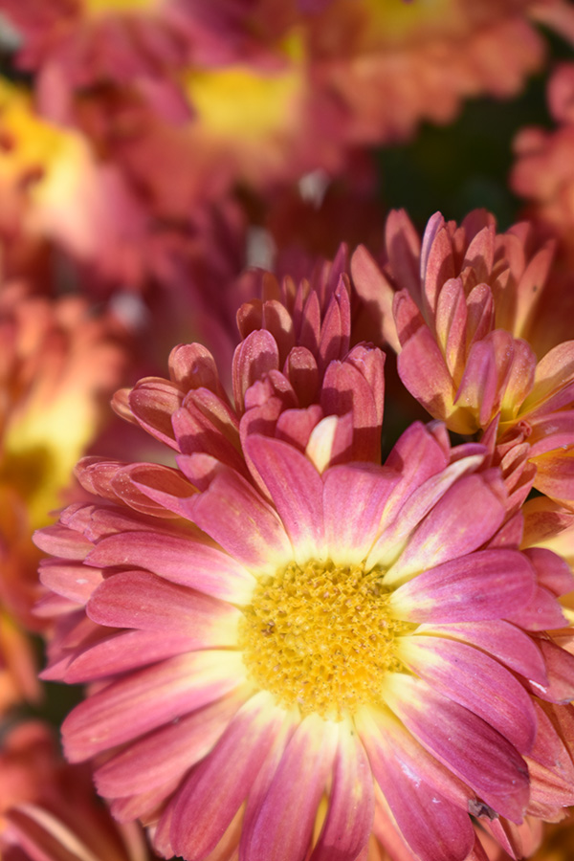
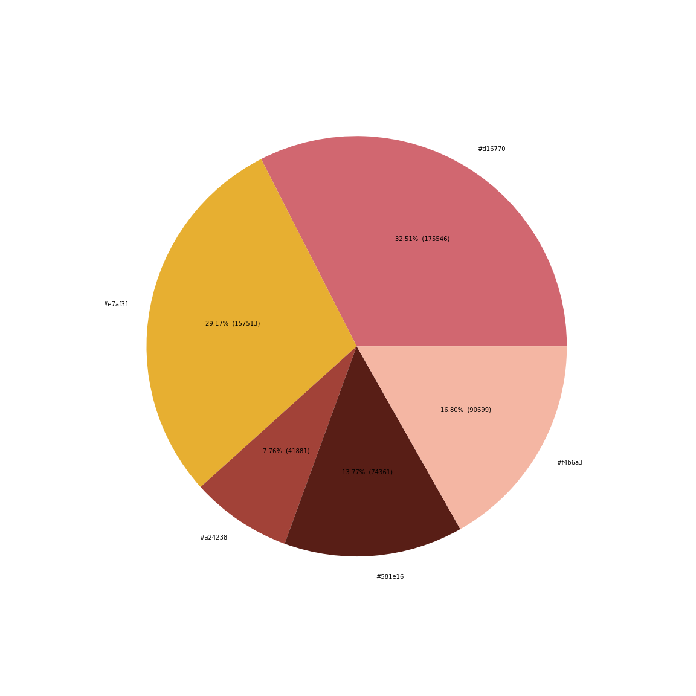
2-1. Analogous Example
Explain color harmony with color combination: Analogous color scheme with yellow and pink.
Write 5 hex colors with percentages: #d16770(32.51%),#e7af31(29.17%),#f4b6a3(16.80%),#a24238(7.76%), #58le16(13.77%)
Which color is the most used? #d16770
What are analogous colors (color and percentage)? #d16770(32.51%),#e7af31(29.17%), #f4b6a3(16.80%)
What is the colors which are not analogous? #a24238(7.76%), #58le16(13.77%)

Slide 9
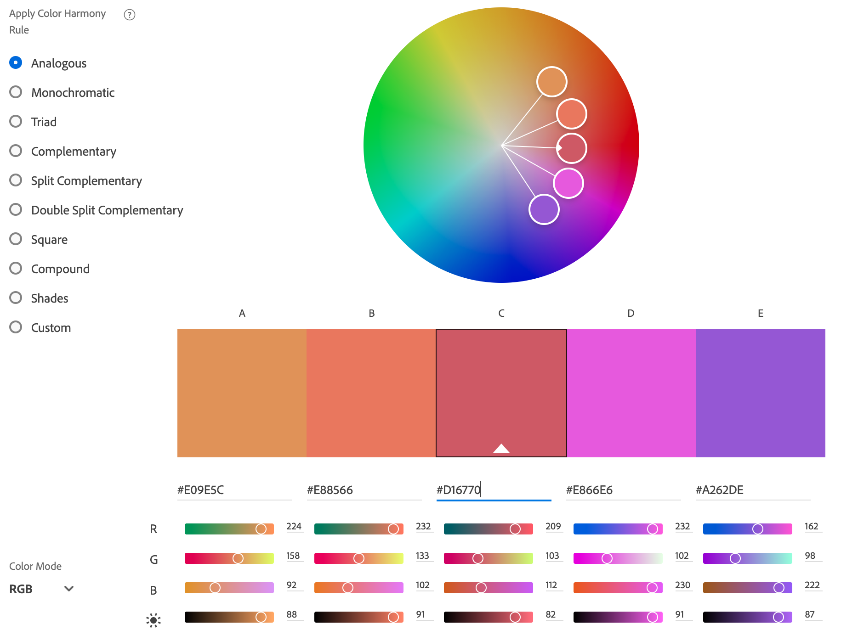
Improvement plan based on color analysis
6. Please write any suggestions to have better color harmony (2-3 sentences).
This photo used good balance and harmonies of using analogous colors. You can see #e7af3,# f4b6af, #d16770 are matched with A, B, C on the color wheel. If I want to add more colors, any purple color will be good for harmony.

Slide 10
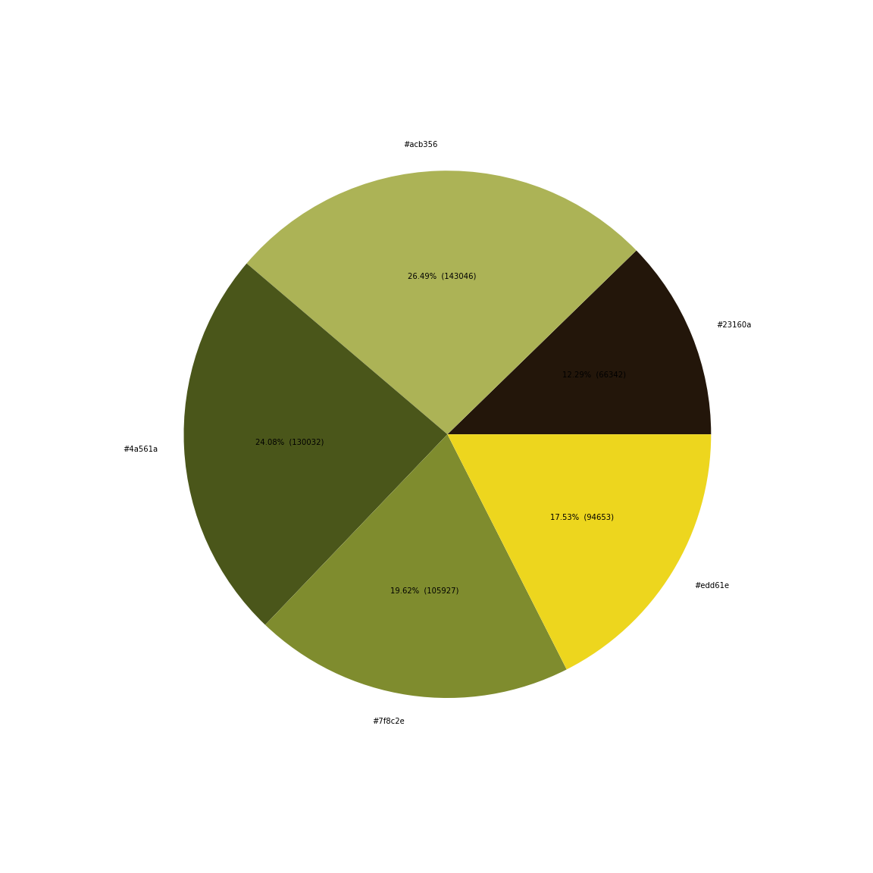
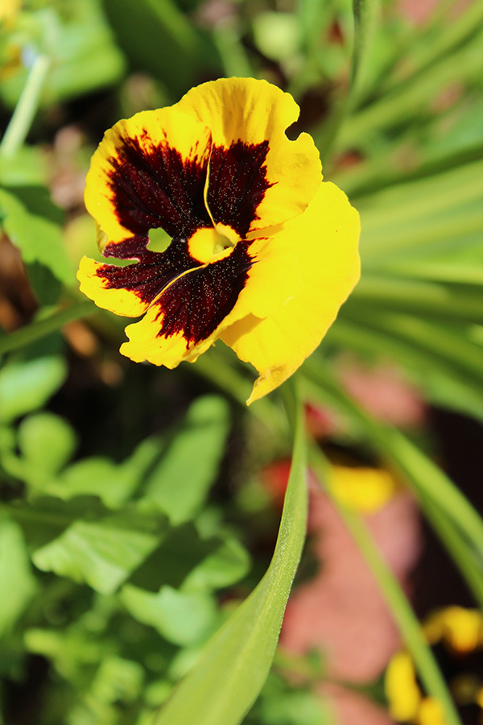
2-2. Analogous
Explain color harmony with color combination: Analogous color scheme with yellow and pink.
Write 5 hex colors with percentages:
What is the color of the main subject? (color and percentage)
What are analogous colors (color and percentage)?
What is the colors which are not analogous (color and percentage)?

Slide 11
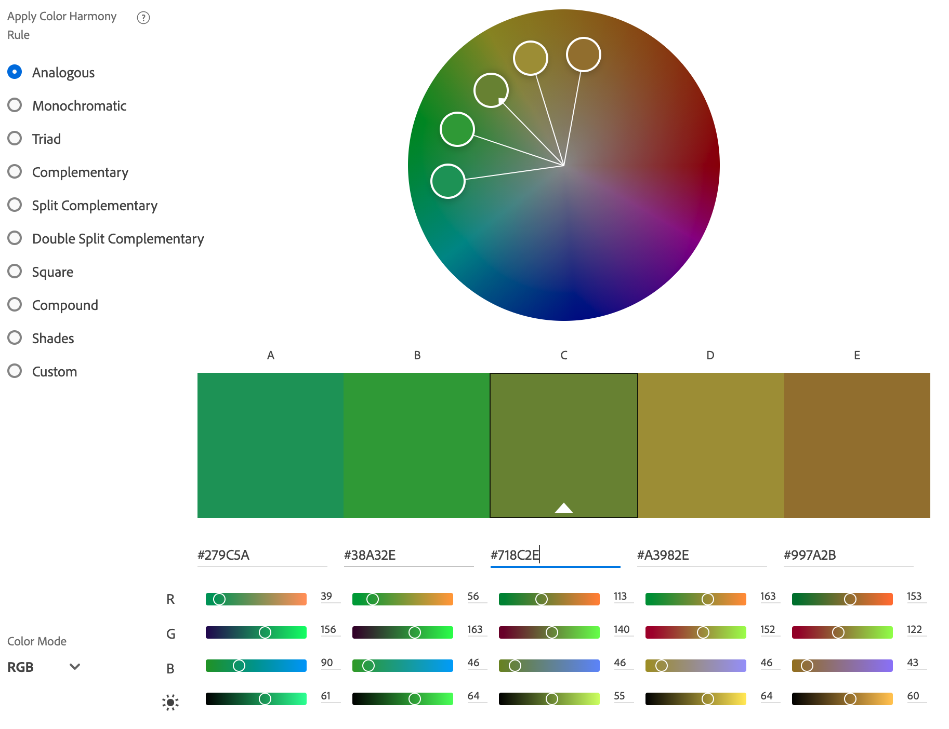
Improvement plan based on color analysis
6. Please write any suggestions to have better color harmony (2-3 sentences).

Slide 12
Student Practice: Complimentary scheme

Slide 13
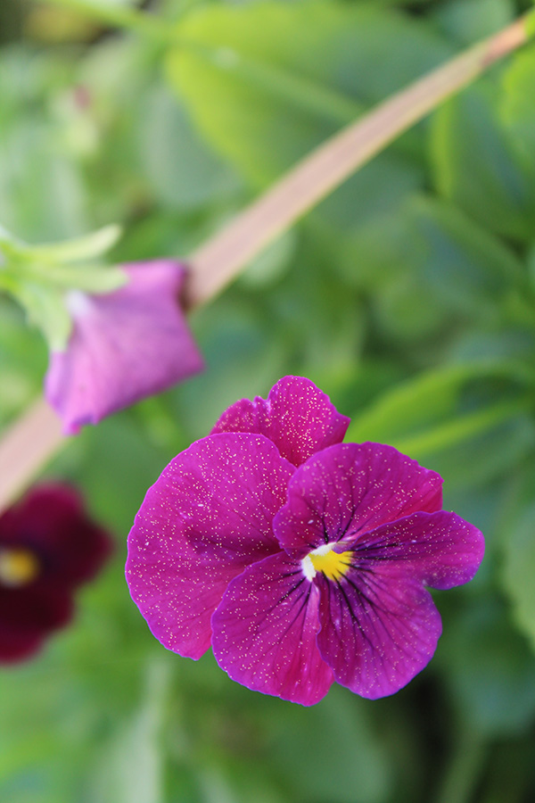
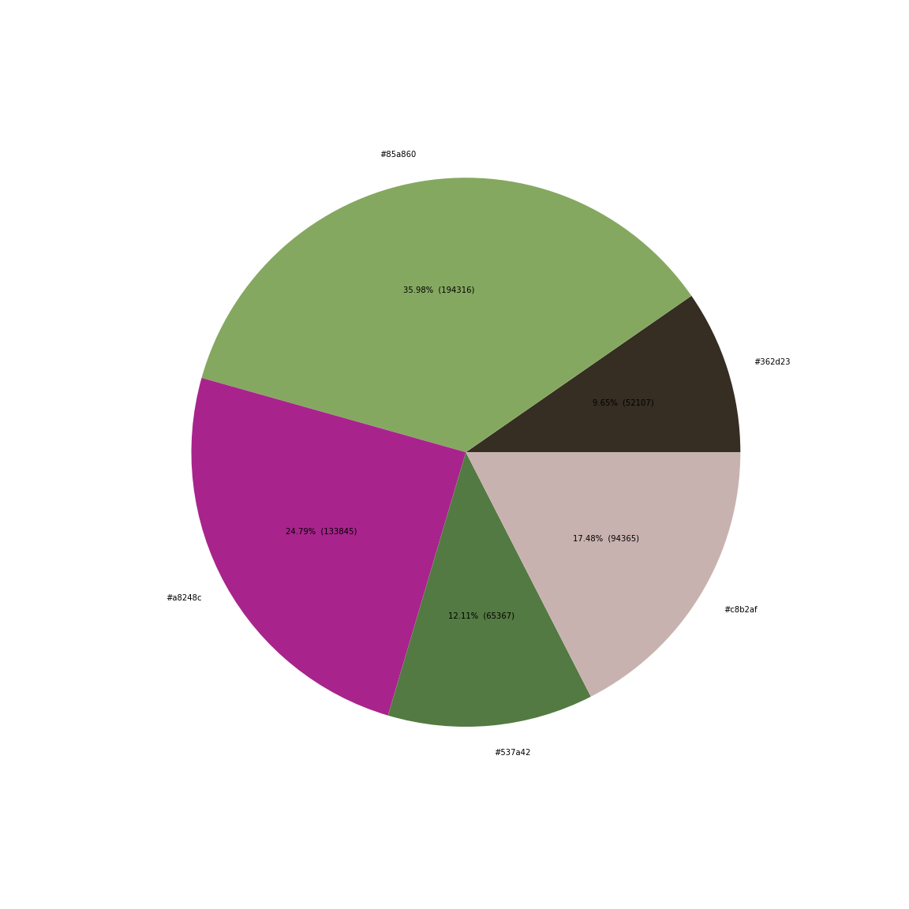
3-1. Complementary Example
Explain color harmony with color combination: complementary color scheme with purple and green.
Write 5 hex colors with percentages: #85a860(35.98%),#a8248c(24.79%),#537a42(12.11%),#c8b2af(17.48%),#362d23(9.65%).
What is the color of the main subject? (color and percentage) #85a860(35.98%)
What are complementary colors (color and percentage)? Purple: #a8248c(24.79%), Green: #537a42(12.11%), #85a860(35.98%)
What is the colors which are not complementary (color and percentage)? #c8b2af(17.48%),#362d23(9.65%)

Slide 14
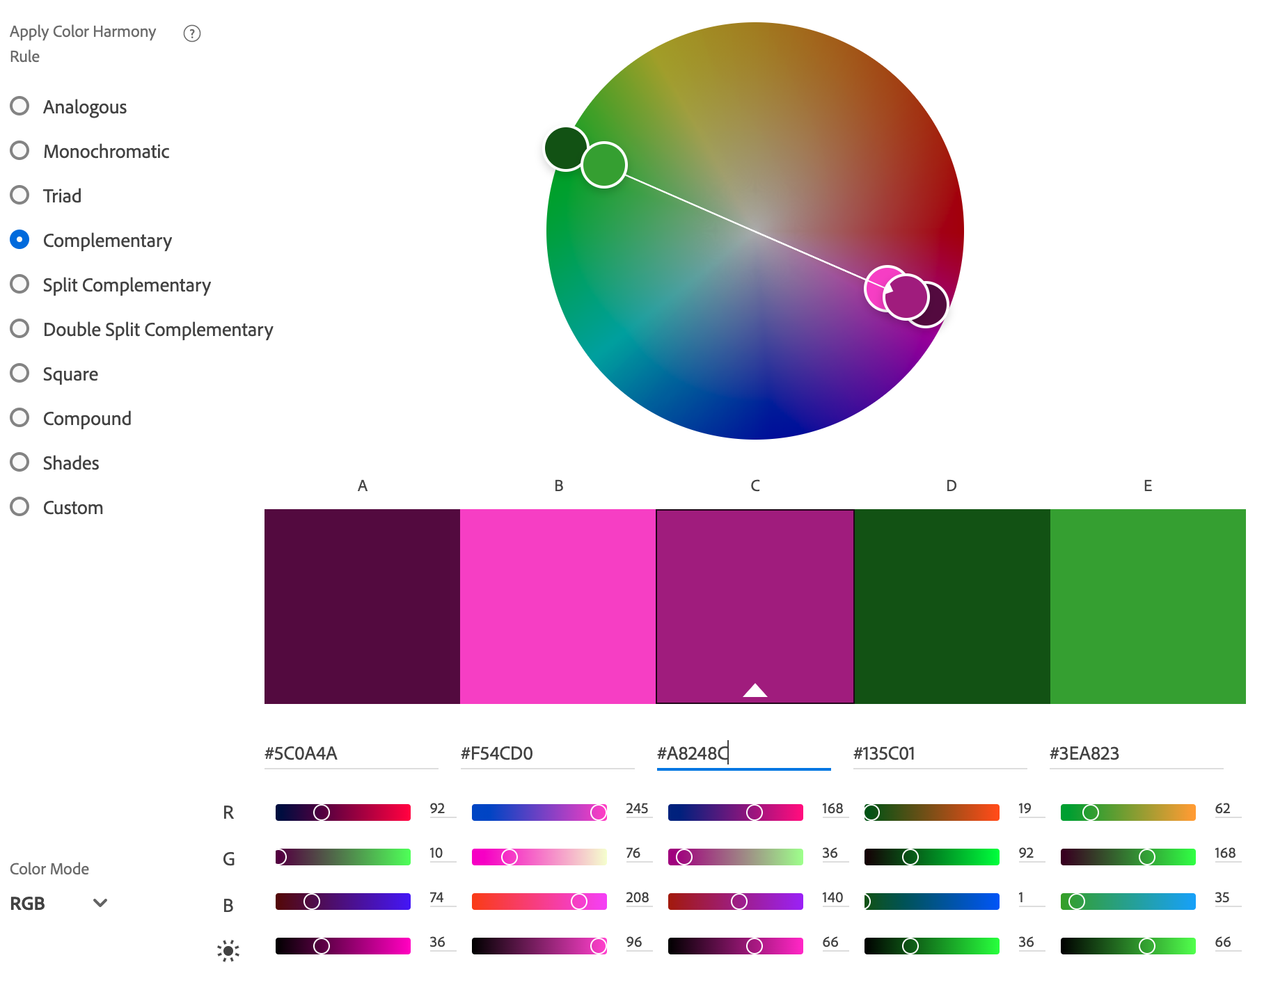
Improvement plan based on color analysis
6. Please write any suggestions to have better color harmony (2-3 sentences).
This photo has a good complimentary color scheme. The purple flower is focused and saturated to get the most attention against green background.

Slide 15
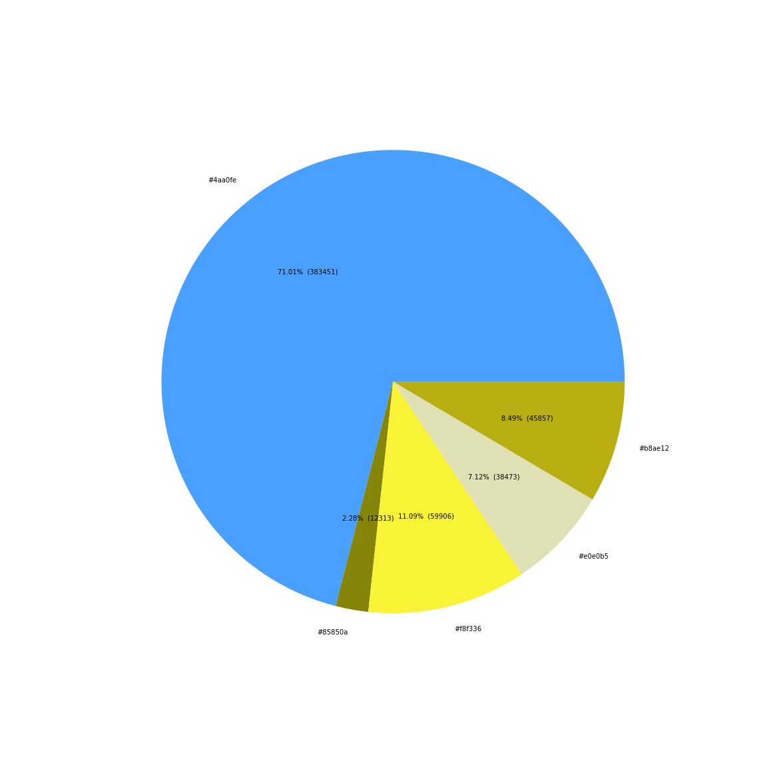
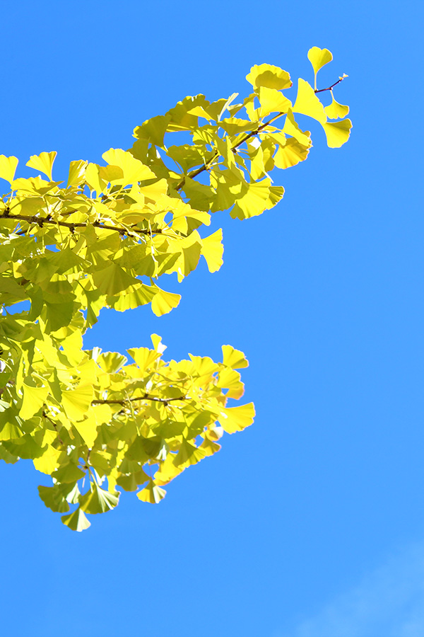
3-2. Complementary
Explain color harmony with color combination: complementary color scheme with orange and blue.
Write 5 hex colors with percentages:
What is the color of the main subject? (color and percentage)
What are complementary colors (color and percentage)?
What is the colors which are not complementary (color and percentage)?

Slide 16
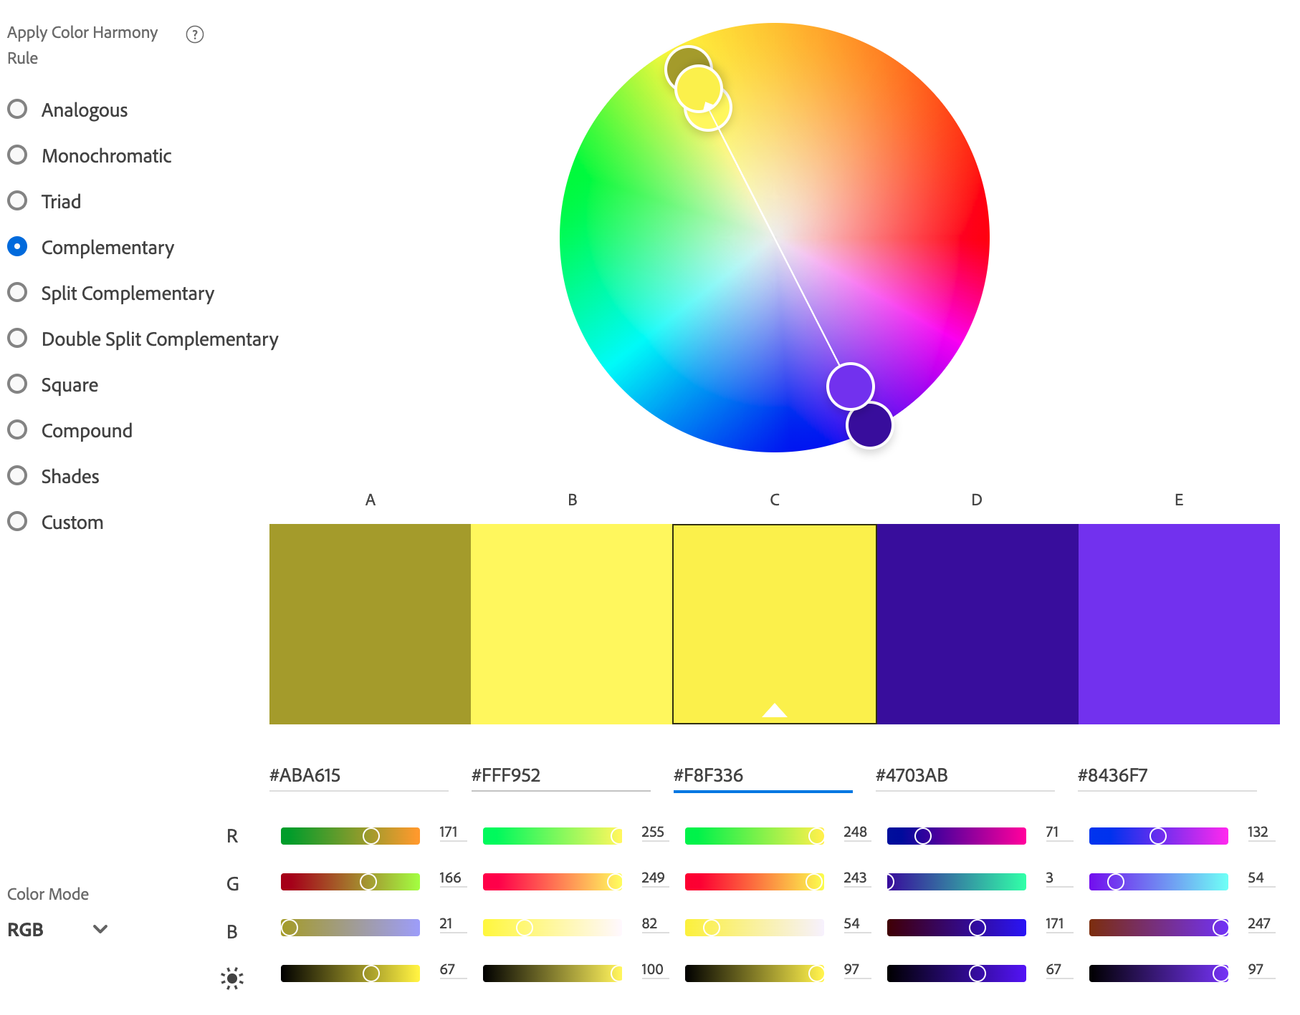
Improvement plan based on color analysis
6. Please write any suggestions to have better color harmony (2-3 sentences).

